Slide 1
NetFlix DataSEt
Manjula M

Slide 2
AGENDA
1) What does DataSet show abt movies and Tv show
2)

Slide 3
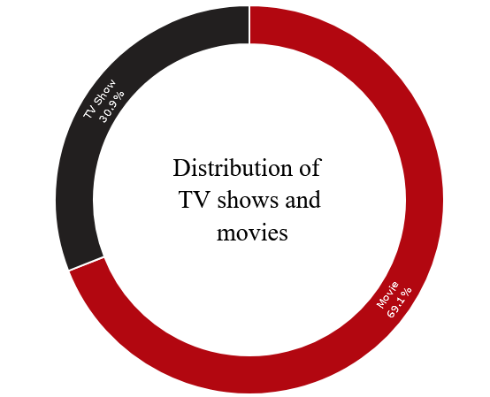
Facts from DataSEt

Slide 4
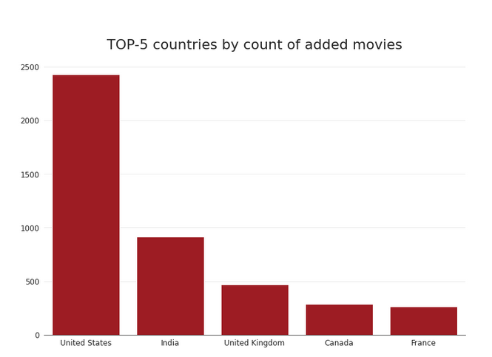
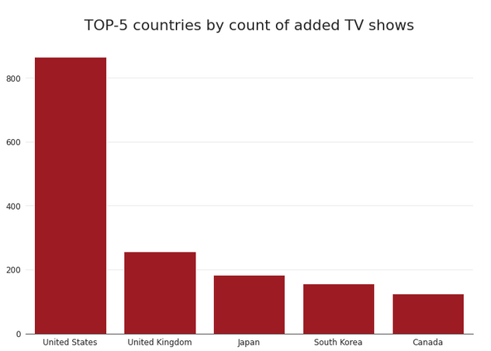
Movies vs TV Shows

Slide 5
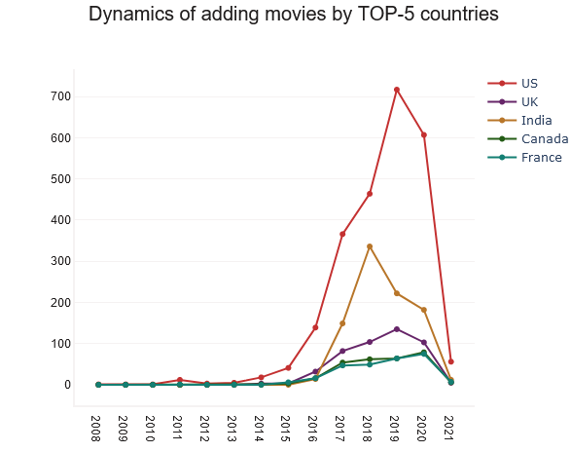
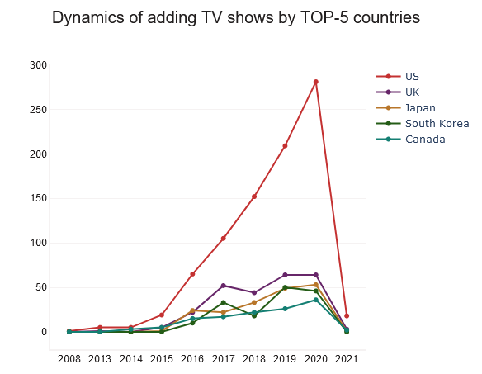
Dynamics of adding Movies and TV Shows
Movies

Slide 6
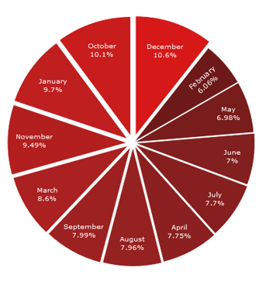
Distribution of Content by month

Slide 7
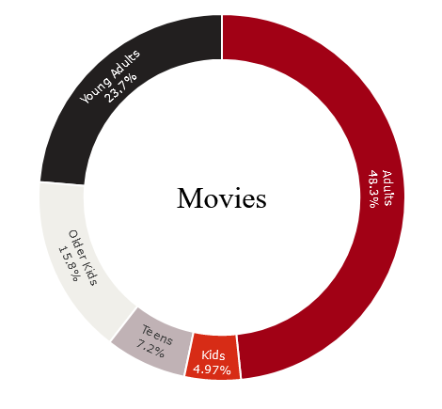
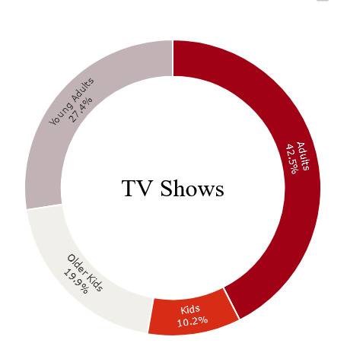
Age Groups

Slide 8
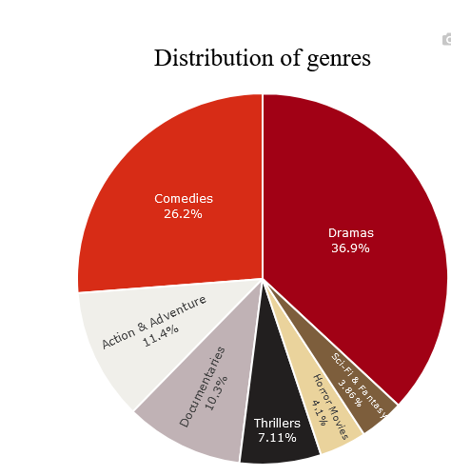




Slide 9
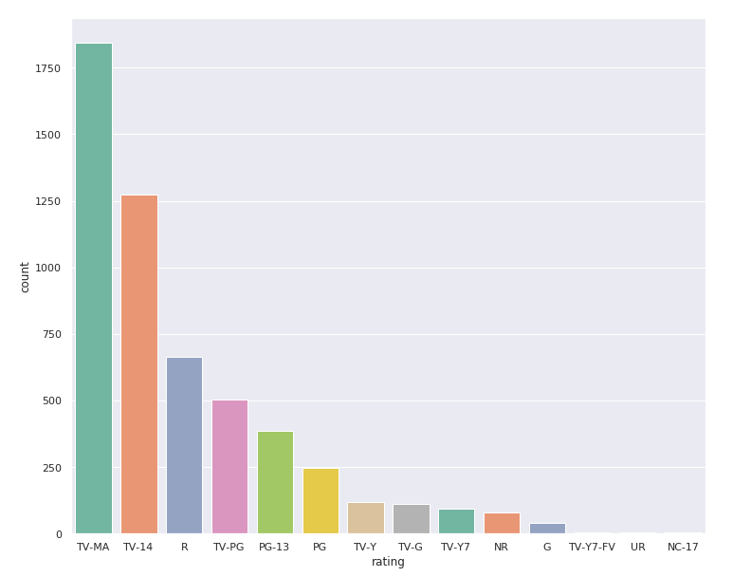
Movie Rating Analysis

Slide 10
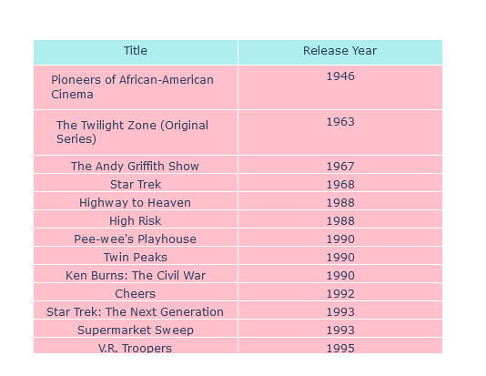

Slide 11
THANK YOU
Source: Kaggle

